Slide 1
Hash Table
Parinya Sanguansat

Slide 2
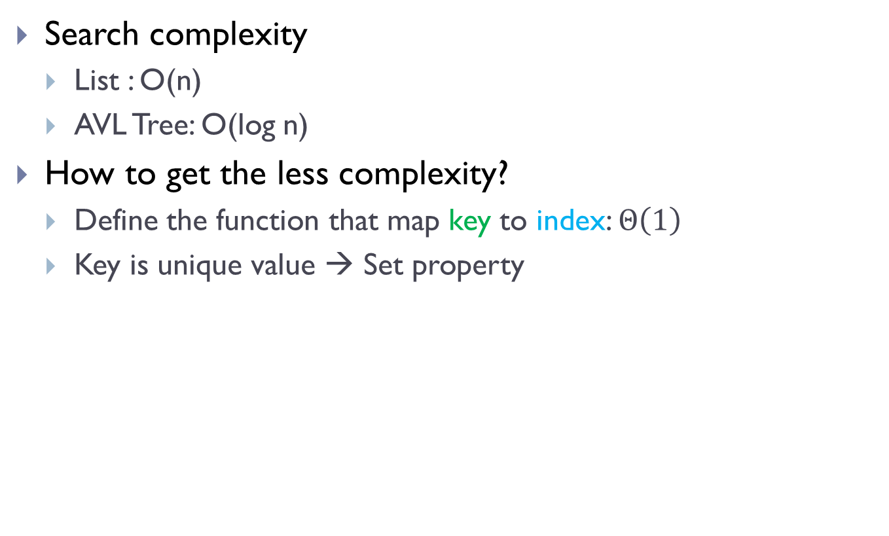
Why we need hash table?
Search complexity
List : O(n)
AVL Tree: O(log n)
How to get the less complexity?
Define the function that map key to index: $Θ\left(1\right)$
Key is unique value → Set property
0 | 1 | 2 | 3 | 4 | 5 | 6 | 7 | 8 | 9
12401
2633
4751
7864
685
0891
f(key) = key / 10 % 10

Slide 3
Table
public class Table
{
private object[] table;
private int SIZE = 0;
public Table(int m) { table = new object[m]; }
public bool isEmpty() { return SIZE == 0; }
public int size() { return SIZE; }
public void add(object x)
{
if (table[f(x)] == null)
{ ++SIZE; table[f(x)] = x; }
}
public void remove(object x)
{
if (table[f(x)] != null && table[f(x)].Equals(x))
{ --SIZE; table[f(x)] = null; }
}
public bool contains(object x)
{
return table[f(x)] != null && table[f(x)].Equals(x);
}
private int f(object x)
{
return ((int)x) / 10 % 10;
}
}

Slide 4
Collision
The function maps the different key to the same index
f(key) = key / 10 % 10
18498
0 | 1 | 2 | 3 | 4 | 5 | 6 | 7 | 8 | 9
12401
2633
4751
7864
685
0891

Slide 5
Separate Chaining
Problem of class Table
We need a large table to store the data
Separate Chaining
Share the index by linked list
0 |  |  | 101 |  |  | 203
1
2 |  |  | 421 |  |  | 21
3 |  |  | 433
4 |  |  | 741 |  |  | 642
5 |  |  | 855 |  |  | 951
6 |  |  | 163 |  |  | 762 |  |  | 766

Slide 6
SeparateChaining
public class SeparateChaining
{
private LinkedList[] table;
private int SIZE;
public SeparateChaining(int m)
{
table = new LinkedList[m];
for (int i = 0; i < table.Length; i++)
table[i] = new LinkedList();
}
public int size() { return SIZE; }
public bool isEmpty() { return SIZE == 0; }
public bool contains(object x)
{ return table[f(x)].contains(x); }
public void add(object x)
{ table[f(x)].add(0, x); SIZE++; }
public void remove(object x)
{
int i = f(x);
int s = table[i].size();
table[i].remove(x);
if (s > table[i].size()) SIZE--;
}
private int f(object x)
{ return ((int)x) / 10 % 10; }
}

Slide 7
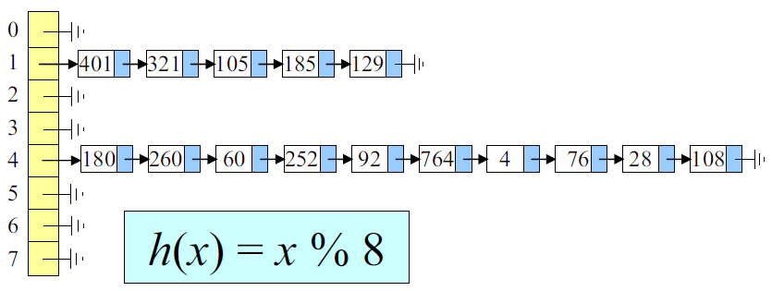
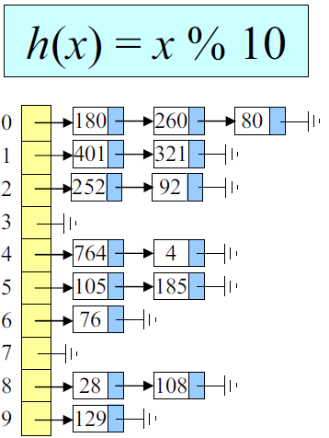

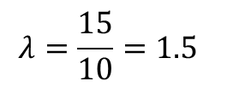

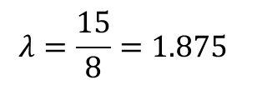
Load factor
Load factor:
Small $λ$ is good
$$λ=\frac{n}{m}$$
Number of data
Size of table
$$λ=\frac{15}{10}=1.5$$
$$λ=\frac{15}{8}=1.875$$

Slide 8
Hash function
We need the function that maps large data sets to smaller data sets of a fixed length with low load factor
How to create hash function
Digit analysis
Multiplicative hashing
Folding
Modulus hashing

Slide 9
Digit analysis
Consider some digits of key
Example: student id
If we want to store only CPE and IT students in 2554
Only the fifth and 3 last digits are considered
key = 5452300104
k1 = key % 1000
k2 = key / 100000 % 10
K3 = k2 * 1000 + k1
5452300104
5452300104

Slide 10

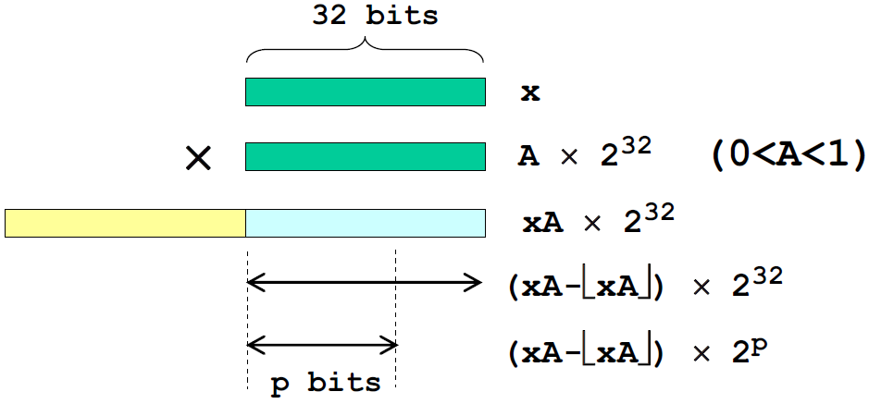
Multiplicative hashing
Multiply key by a real number (0,1)
Multiply the remainder by the table size (m = 2^{p})

Slide 11
Multiplicative hashing: Fibonacci Hashing
Set A = golden ratio 0.610339887…
int multHash(int x, int p)
{
long s = 2654435769L; // 0.618... * 2^32
long hash = (s * x) & 0xFFFFFFFFL;
return (int)(hash >> (32 - p));
}
for (int i = 0; i < 10; i++)
Console.WriteLine(multHash(i, 16));
0,40503,15470,55974,30941,5909,46412,21380,61883,36851

Slide 12
C#: Bit operators
& = AND
| = OR
^ = XOR
! = NOT
~ = COMPLEMENT
X << n = left-shift (X * 2^{n})
X >> n = right-shift (X / 2^{n})

Slide 13
Folding
Partition key and combine together with some operators
plus, xor, …
2 | 5 | 0 | 1
4 | 7 | 8 | 3
9 | 6 | 1 | 0
2 | 5 | 0 | 1
4 | 7 | 8 | 3
9 | 6 | 1 | 0
1 | 6 | 8 | 9 | 4

Slide 14
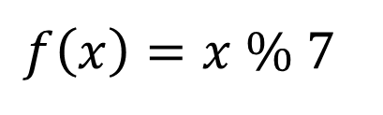

Modulus hashing
$f\left(x\right)=x \% p$
Good choice of $p$ is a prime number
$$f\left(x\right)=x \% 7$$
0 |  |  | 49 |  |  | 28
1
2 |  |  | 58 |  |  | 86
3 |  |  | 17
4 |  |  | 32 |  |  | 67
5 |  |  | 40 |  |  | 47
6 |  |  | 90 |  |  | 20 |  |  | 83

Slide 15
How to handle non-numeric data
Convert it to numeric data
Double to long: DoubleToInt64Bits(value)
Float to int: BitConverter.ToInt32(BitConverter.GetBytes(value), 0)
bool: true → 1 and false → 0
string: convert to base-26 integer
"DATA“ → 3x26³ + 0x26² + 19x26¹ + 0x26⁰ = 53222
object: sum of all members

Slide 16
C#: object.GetHashCode
Return the hashcode
If two objects of the same type represent the same value, the hash function must return the same constant value for either object.
For the best performance, a hash function must generate a random distribution for all input.
The hash function must return exactly the same value regardless of any changes that are made to the object.
using System;
public struct Point
{
public int x;
public int y;
public override int GetHashCode()
{
return x ^ y;
}
}

Slide 17
Rehashing
Reduce the load factor
private double threshold = 4;
public void add(object x)
{
table[f(x)].add(0, x);
SIZE++;
if ((double)SIZE / (double)table.Length >= threshold)
rehash();
}
private void rehash()
{
LinkedList[] oldTable = table;
table = new LinkedList[2 * table.Length];
for (int i = 0; i < table.Length; i++)
table[i] = new LinkedList();
for (int i = 0; i < oldTable.Length; i++)
{
object[] items = oldTable[i].toArray();
for (int j = 0; j < items.Length; j++)
{
table[f(items[j])].add(0, items[j]);
}
}
}

Slide 18
Open addressing
Separate chaining
Wasted memory for link
No relation for each linked list
Without linked list
Linear Probing
Quadratic Probing
Double Hashing

Slide 19
Linear Probing
Use the next slot to store data
f(key) = key / 10 % 10
0 | 1 | 2 | 3 | 4 | 5 | 6 | 7 | 8 | 9
12401
2633
4751
7864
685
0891
18498

Slide 20
LinearProbingHashSet
public class LinearProbingHashSet : Set
{
private object[] table;
private int SIZE;
private int numNonNulls;
public LinearProbingHashSet(int m)
{ table = new object[m]; }
public bool isEmpty() { return SIZE == 0; }
public int size() { return SIZE; }
public bool contains(object e)
{ return table[indexOf(e)] != null; }
public void add(object e){}
public void remove(object e){}
private int indexOf(object e){}
private int f(object e){}
private void rehash() {}
}

Slide 21
LinearProbingHashSet: add
void add(object e)
private int indexOf(object e)
{
int h = f(e);
for (int j = 0; j < table.Length; j++)
{
if (table[h] == null) return h;
if (table[h].Equals(e)) return h;
h = (h + 1) % table.Length;
}
throw new InvalidOperationException();
}
public void add(object e)
{
int i = indexOf(e);
if (table[i] == null)
{
table[i] = e;
SIZE++; numNonNulls++;
if (numNonNulls > table.Length / 2)
rehash();
}
}
rehash

Slide 22
LinearProbingHashSet: remove
Cannot set to null
f(key) = key / 10 % 10
0 | 1 | 2 | 3 | 4 | 5 | 6 | 7 | 8 | 9
12401
18498
2633
4751
7864
685
0891
private int indexOf(object e)
{
int h = f(e);
for (int j = 0; j < table.Length; j++)
{
if (table[h] == null) return h;
if (table[h].Equals(e)) return h;
h = (h + 1) % table.Length;
}
throw new InvalidOperationException();
}
public void remove(object e)
{
int i = indexOf(e);
if (table[i] != null)
{
table[i] = DELETED;
SIZE--;
}
}
private static readonly object DELETED = new object();

Slide 23
LinearProbingHashSet: add
Reuse the DELETED slot
If DELETED is found, remember the first DELETED
Continue search until found or null(set)
Reuse the first DELETED, if it was found
public void add(object e)
{
int empty = -1;
int h = f(e);
for (int j = 0; j < table.Length; j++)
{
if (table[h] == DELETED && empty == -1) empty = h;
if (table[h] == null || table[h].Equals(e)) break;
h = (h + 1) % table.Length;
}
if (table[h] == null)
{
if (empty != -1) h = empty;
table[h] = e;
SIZE++; if (empty == -1) numNonNulls++;
if (numNonNulls > table.Length / 2)
rehash();
}
}

Slide 24
LinearProbingHashSet: f and rehash
int f(object e)
void rehash()
private int f(object e)
{
return Math.Abs(e.GetHashCode()) % table.Length;
}
private void rehash()
{
object[] old = table;
table = new object[4 * SIZE]; // load factor <= 0.25
SIZE = numNonNulls = 0;
for (int i = 0; i < old.Length; i++)
if (old[i] != null && old[i] != DELETED) add(old[i]);
}

Slide 25



Quadratic Probing
Linear Probing
Cookie monster effect
Primary clustering
Quadratic Probing
Skip by the squared step:
Or it is a sequence 1, 3, 5, 7, …
The table size (m) must be prime
$$f_{j}\left(x\right)=\left(f\left(x\right)+j^{2}\right) \% m$$
$$f_{j}\left(x\right)=\left(f_{j−1}\left(x\right)+2j−1\right) \% m$$

Slide 26


Double Hashing
Quadratic Probing
Some slots always be skipped
Double Hashing
Use another mapping function for stepping
f(key) = key % 13
(4+1²)%13 = 5
(4+2²)%13 = 8
(4+3²)%13 = 0
(4+4²)%13 = 7
(4+5²)%13 = 3
(4+6²)%13 = 1
(4+7²)%13 = 1
(4+8²)%13 = 3
(4+9²)%13 = 7
(4+10²)%13 = 0
(4+11²)%13 = 8
(4+12²)%13 = 5
(4+13²)%13 = 4
:
0 | 1 | 2 | 3 | 4 | 5 | 6 | 7 | 8 | 9 | 10 | 11 | 12
0 | 1 |  | 17 | 4 | 5 |  | 7 | 8
$$f_{j}\left(x\right)=\left(f\left(x\right)+jg(x)\right) \% m$$
$$f_{j}\left(x\right)=\left(f_{j−1}\left(x\right)+g(x)\right) \% m$$
$g\left(x\right)=P−\left(x \% P\right), P=a prime number<m and GCD\left(P,m\right)=1$

Slide 27
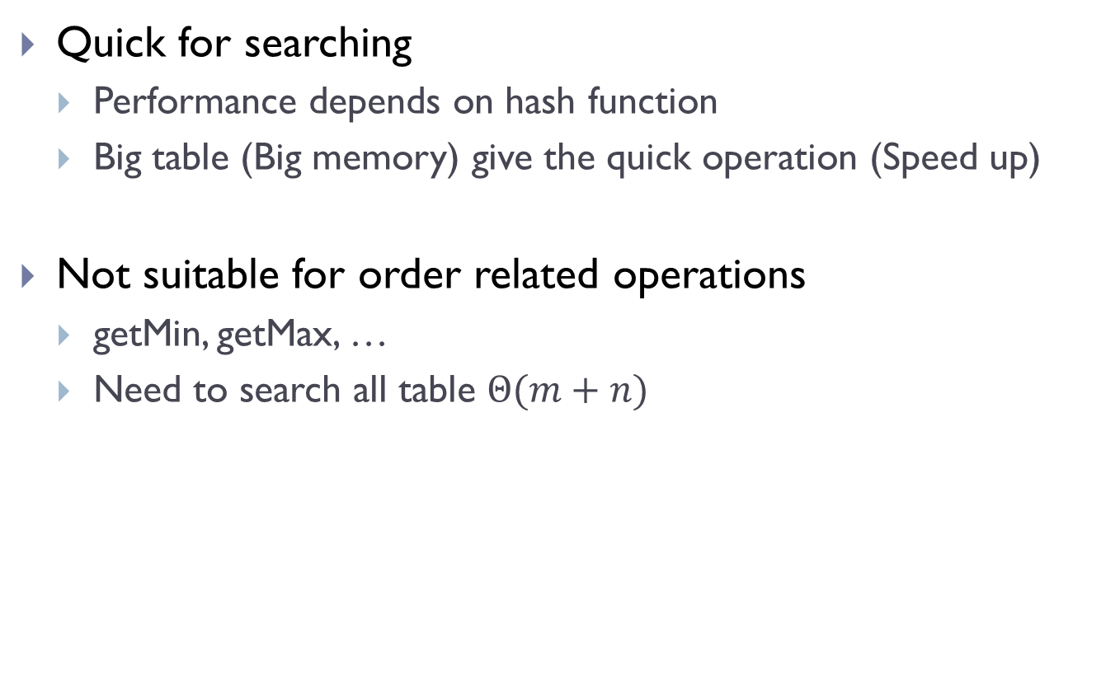
Conclusions
Quick for searching
Performance depends on hash function
Big table (Big memory) give the quick operation (Speed up)
Not suitable for order related operations
getMin, getMax, …
Need to search all table $Θ(m+n)$

Slide 28
Homework: Quadratic Probing and Double hashing
Create class QuadraticProbingHashSet
Inherited from Set
Table size must be a prime
Create class DoubleHashingHashSet
Inherited from Set
Table size must be a prime
Use g(x) = 11 – (Math.abs(x.GetHashCode()) % 11)

